Slide 1
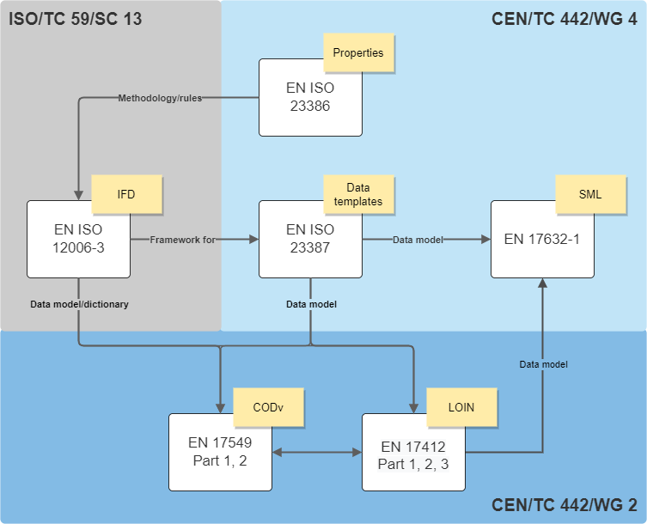

Slide 2
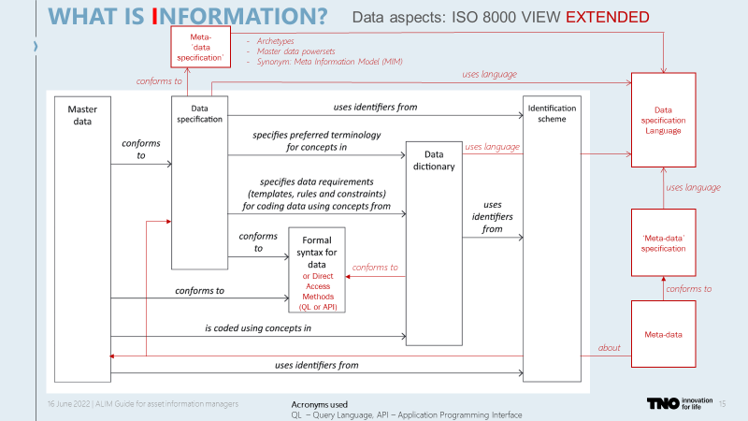
Data Sets

Slide 3
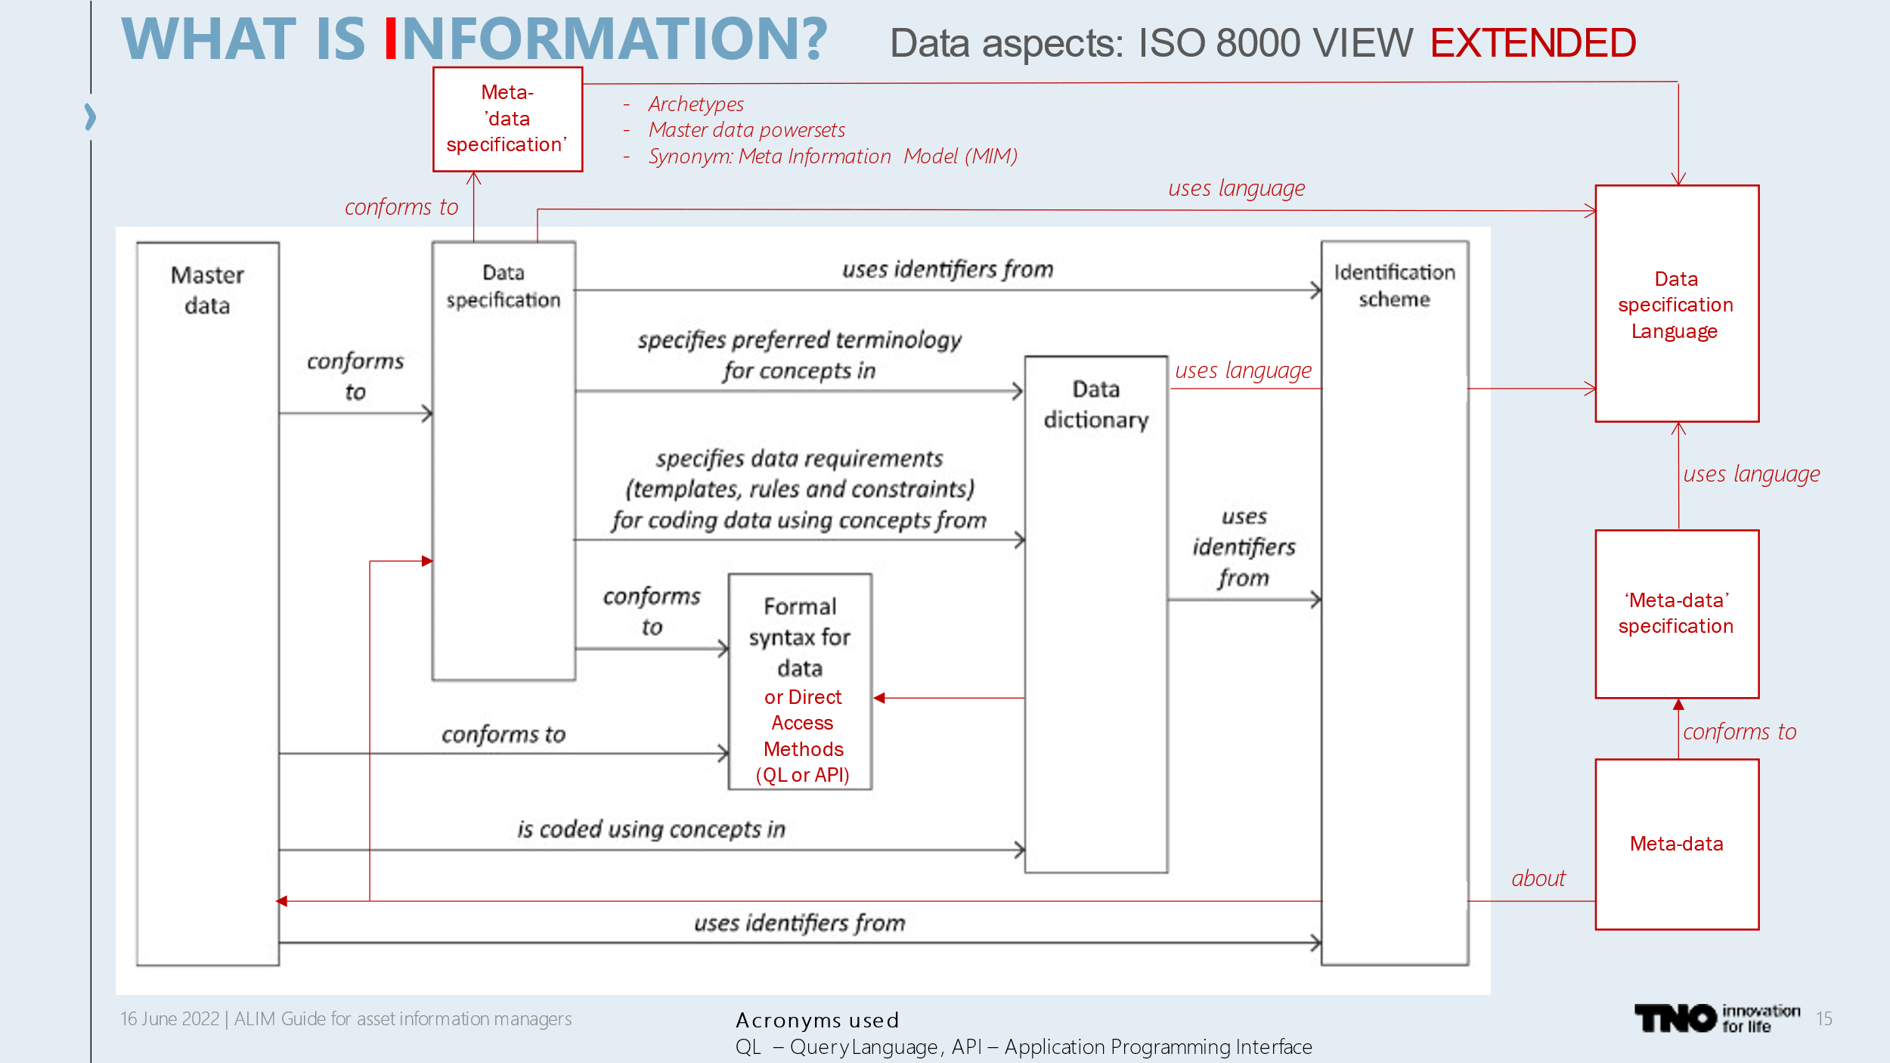
Application towards CEN TC442
ISO 12006-3 (IFD)
Data template meta model EN ISO 23387
CEN 17412
LOIN
preEN 17632 (SML)
Language-level
UML, Express, XSD, RDF, RDFS, OWL, SHACL, GraphQL Schema
bSI IFC 4.3
prEN
17549
IFD instances (like bSDD)
URI, UUID, UOI, etc
Data template instances
preEN 17632 (SML)
Top-level Model
Note:
Terms, defs only!
conforms to
EN ISO 23386
“attributes” for properties
SPFF, XML, JSON, RDF serialisation: RDF-XML, Turtle/TriG, JSON-LD
ISO/IEC 9075:2016 (SQL), W3C SPARQL, GraphQL

Slide 4
Format = Turtle (triples + ; and . And @nl)
Master data
md:Door_1
rdf:type ds:Door ; -- link to ontology
ds:height “2 meter” ;
meta:measuredBy “Jack” .
ds:Door
rdf:type owl:Class ;
rdfs:seeAlso dd:Door ; -- link to dictionary
rdfs:subClassOf sml:DiscreteObject .
ds:height
rdf:type owl:DatatypeProperty ;
meta:status “Stable” .
dd:Door
rdf:type skos:Concept ;
rdfs:label “Deur”@nl .
meta:status
rdf:type rdfs:property .
meta:measuredBy
rdf:type rdfs:property .
Data specification (ds)
(ontology)
Reused
Data specification (sml)
Data dictionary (dd)
Meta-data
Data Specification
Language
(rdf, rdfs, owl, skos)
Meta-data
specification

Slide 5
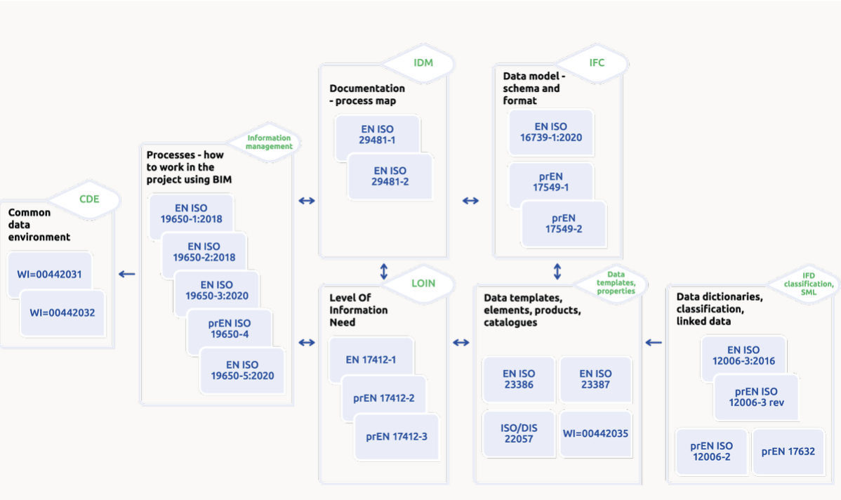

Slide 6
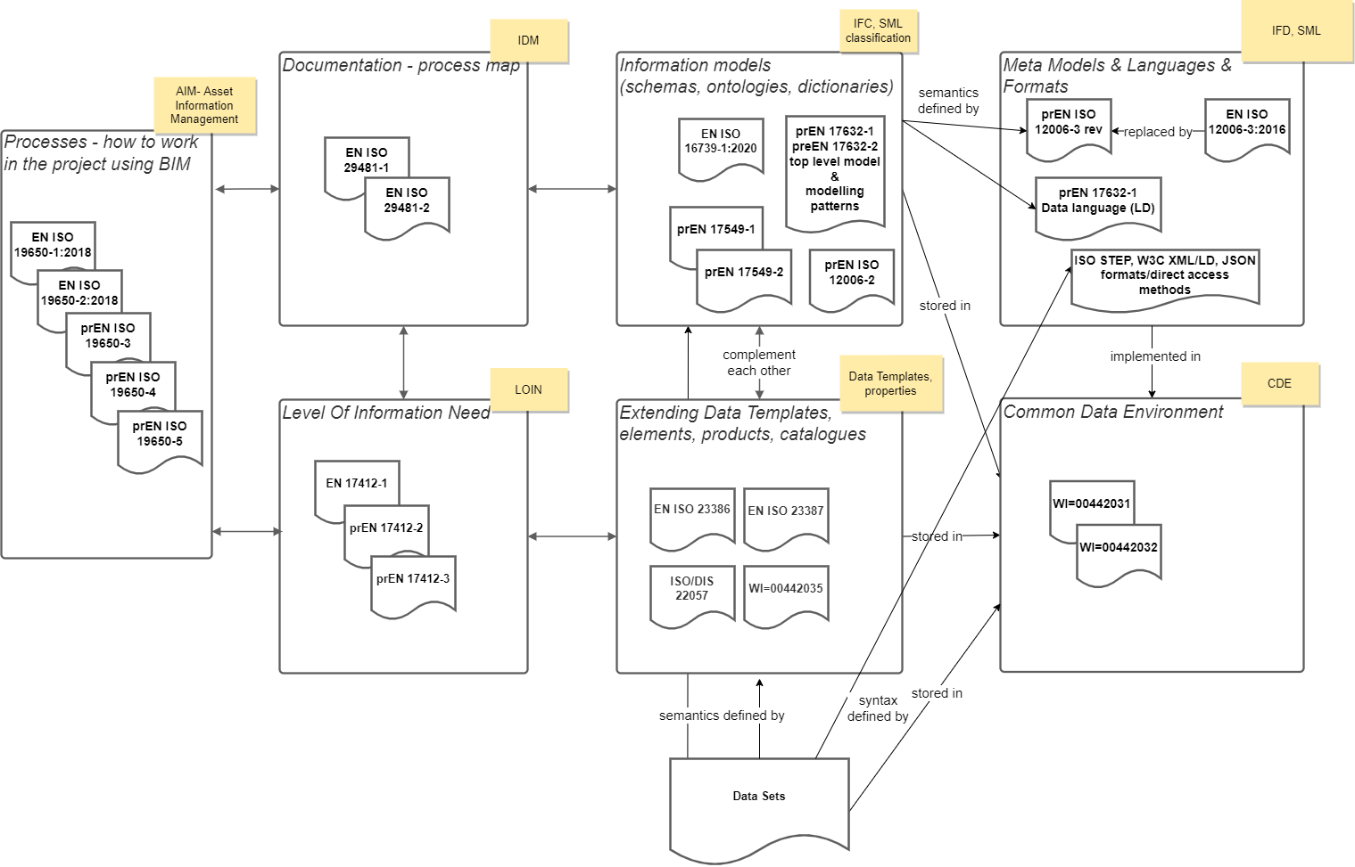
Proposed Update No. 1

